Slide 1



Doctoral Studies Center in Information and Engineering Sciences and Technologies (ST2I)
Cooperative Game Theory for Explainable AI in Recommendation Systems:
A Shapley Framework for Actionable Insight
PhD Viva Presented by: Mouad LOUHICHI
Jury members:
President | [President to complete] |  | [Institution]
Supervisor | Pr. Mohamed LAZAAR | PES | ENSIAS, Mohammed V University, Rabat
Reviewer | [Reviewer to complete] |  | [Institution]
Reviewer | [Reviewer to complete] |  | [Institution]
Reviewer | [Reviewer to complete] |  | [Institution]
Examiner | [Examiner to complete] |  | [Institution]
Examiner | [Examiner to complete] |  | [Institution]
Examiner | [Examiner to complete] |  | [Institution]
Guest | [Guest to complete] |  | [Institution]
Notes:
Good morning. Thank you, President and Professors, for the time you are giving me to present and discuss my thesis. My name is Mouad Louhichi. My thesis is titled Cooperative Game Theory for Explainable AI in Recommendation Systems: A Shapley Framework for Actionable Insight, supervised by Professor Mohamed Lazaar. It advances one idea: that Shapley-value attribution is not just a post-hoc explanation, but a single formal mechanism that can explain black-box clustering, stay coherent under hierarchical scale, and finally act as an in-training signal inside a recommender.

Slide 2







VIVA Outline
Introduction
Motivation
Actionable insight
Why XAI
Context & Problematic
Limitations
Research gap
Protocols
Datasets
Baselines
Metrics
Hardware
Contributions
C1 Explainable clustering
C2 Multi-level XAI
C3 DyHuCoG
Conclusion & Perspectives
Summary
Limitations
Future work
PhD Viva – Mouad LOUHICHI – Cooperative Game Theory & Shapley for XAI in Recommendation Systems
Notes:
I will walk you through five parts: introduction, context and problematic, the shared experimental protocol, then my three contributions, and finally the conclusion and perspectives. Each contribution follows the same structure: objectives, methodology, results, and findings. So you always know where we are.

Slide 3
Introduction
PhD Viva – Mouad LOUHICHI – Cooperative Game Theory & Shapley for XAI in Recommendation Systems
Notes:
Let us begin with the introduction. I will spend a few minutes establishing why explainability is not a nice-to-have but a first-class requirement for recommender systems, and I will define carefully what I mean by an actionable insight.

Slide 4






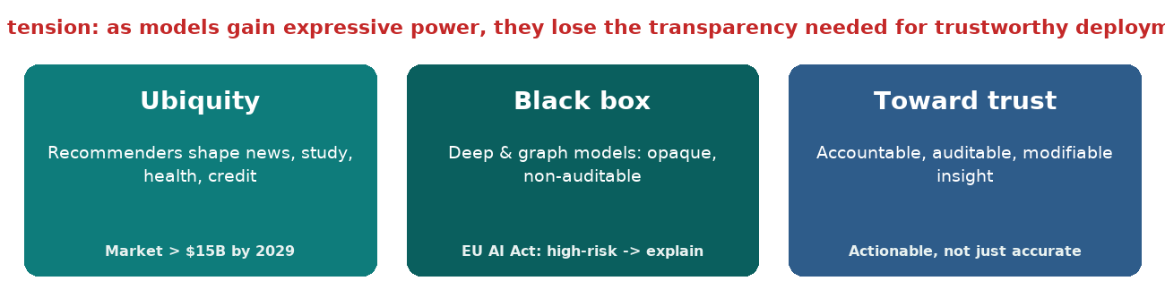
Motivation: Three Questions
Motivation
Actionable Insight
Ubiquity
How do opaque AI systems shape what billions of users see, buy and watch every day?
The Black Box
Why do state-of-the-art recommenders and clustering pipelines remain opaque to users and designers?
Toward Trust
How can transparency be built as part of the model, instead of being bolted on afterwards?
PhD Viva – Mouad LOUHICHI – Cooperative Game Theory & Shapley for XAI in Recommendation Systems
Notes:
Three questions frame the whole work. First, ubiquity: opaque systems mediate what billions of people see, buy and watch every day — not only on streaming platforms but in e-commerce, news feeds and search. Second, the black box: even strong recommenders and clustering pipelines are hard to interrogate — we observe their outputs without understanding why a particular item was chosen. Third, trust: transparency should be built into the modelling logic, not bolted on after the fact. The core tension of the thesis is that as models gain expressive power, they lose the transparency needed for trustworthy deployment. Throughout this work I hold accuracy and interpretability as objectives to be reconciled, not traded against one another.

Slide 5
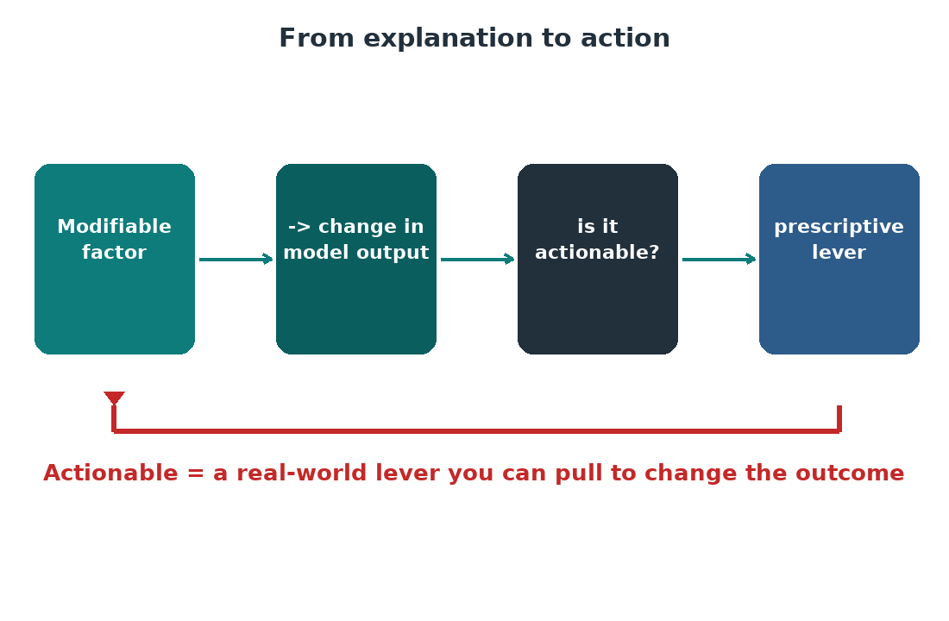
Actionable Insight — the Definition
Motivation
Actionable Insight
Research Context
▪ Definition 1.1 (Actionable insight)
– An explanation is actionable when it identifies at least one modifiable factor whose change is associated with a specifiable change in model output…
– … and that factor is expressible in the semantic vocabulary of the task domain.
▪ Accessibility means the domain's own terms:
– a physicochemical variable (wine), a pollution indicator (air quality), or a preference signal (recommendation).
– not an opaque latent code.
▪ Why: an explanation that identifies a modifiable driver supports intervention, not merely description.
PhD Viva – Mouad LOUHICHI – Cooperative Game Theory & Shapley for XAI in Recommendation Systems
Notes:
We frame the whole thesis around actionable insight. An explanation is actionable when it identifies at least one modifiable factor whose change is associated with a specifiable change in model output, and when that factor is expressible in the semantic vocabulary of the task domain — a physicochemical variable for wine, a pollution indicator for air quality, a preference signal for recommendation. The crucial constraint is that it must not be an opaque latent code. This distinction separates explanations that let a designer intervene and act from those that merely describe what happened. By this definition, a credible explanation is evaluated by whether it supports a downstream decision, not by whether it looks plausible.

Slide 6
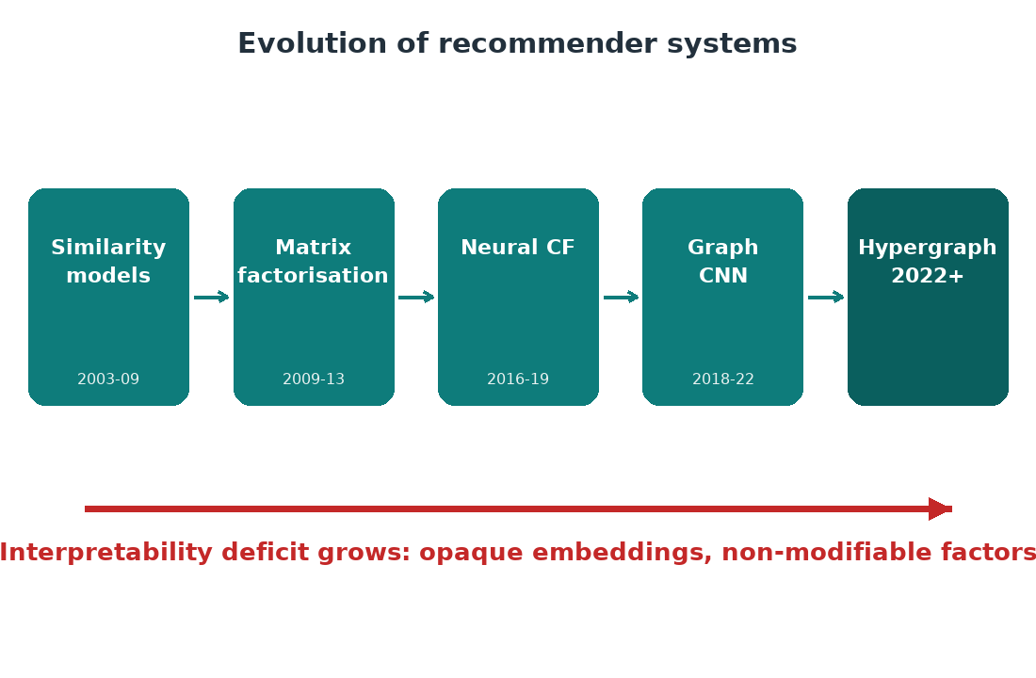

Research Context
Motivation
Actionable Insight
Research Context
▪ Recommenders evolved from similarity filters to complex representation-learning systems on sparse, high-dimensional, dynamic data.
– → MF → neural CF → graph CNNs → hypergraph: each step improved ranking but intensified the interpretability deficit.
▪ Why the deficit matters:
– Undermines user trust.
– Constrains debugging and scientific learning.
– Collides with regulatory expectations (EU AI Act, OECD principles, GDPR).
– EU AI Act (Art. 13) requires high-risk systems to provide explanations in human-understandable terms.
PhD Viva – Mouad LOUHICHI – Cooperative Game Theory & Shapley for XAI in Recommendation Systems
Notes:
The context is the progression from simple to hypergraph recommenders. Matrix factorisation showed that latent factors could capture preferences, but those factors were immediately uninterpretable. Graph and graph-neural-network models improved ranking by exploiting connectivity, yet replaced an opaque latent code with an opaque message-passing mechanism. Finally, hypergraph models added higher-order user-item-context relations, but typically assume that every message contributes uniformly. Each step raised expressiveness while lowering transparency. The deficit matters for trust, debugging and regulation — the EU AI Act, the OECD principles and the GDPR all put a premium on meaningful explanation. That is why a principled attribution mechanism is needed, and why I will argue it should be part of the modelling logic rather than an afterthought.

Slide 7
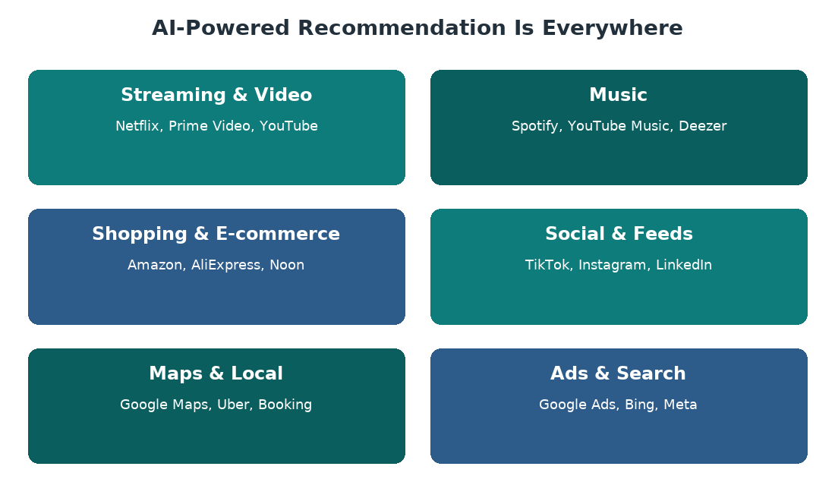

AI-Powered Recommendation Systems Around Us
Motivation
Actionable Insight
Research Context
▪ AI recommendation mediates what billions see, buy and listen to every day:
– Streaming & video: Netflix, Prime Video, YouTube.
– Music: Spotify, YouTube Music, Deezer.
– Shopping & e-commerce: Amazon, AliExpress, Noon.
– Social & feeds: TikTok, Instagram, LinkedIn.
– Maps, ads, search: Google Maps, Uber, Google Ads, Bing.
▪ Accurate yet opaque — the very gap our thesis targets.
PhD Viva – Mouad LOUHICHI – Cooperative Game Theory & Shapley for XAI in Recommendation Systems
Notes:
Recommendation is not a niche technique; it is infrastructure for everyday decisions. Streaming platforms decide what you watch next, music services what you hear, e-commerce what you buy, and social feeds what you read. Each system is remarkably accurate, yet its reasoning is hidden from the user. That ubiquity-plus-opacity is precisely what makes explainability a first-class requirement — and what motivates the three contributions that follow.

Slide 8

Context & Problematic
PhD Viva – Mouad LOUHICHI – Cooperative Game Theory & Shapley for XAI in Recommendation Systems
Notes:
Now let us look more precisely at the problem this thesis addresses. I will quickly survey the paradigm landscape, then identify the structuring limitations and the five research questions, and finally map the three contributions to those questions.

Slide 9

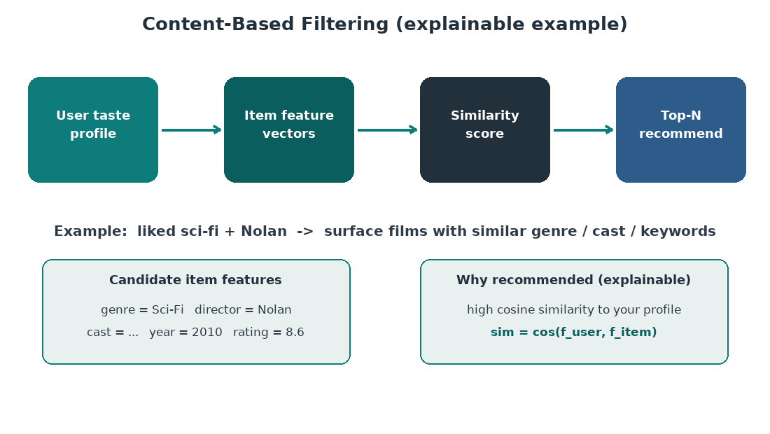

Recommendation & Clustering Paradigms
Paradigms
Problematic
Contributions
▪ Collaborative filtering – users who behaved similarly will value similar items (user-/item-based).
▪ Content-based – recommends items sharing attributes with a user profile.
▪ Hybrid – combines collaborative and content signals.
▪ Matrix factorisation – R ≈ PQᵀ: compact but opaque latent factors.
▪ Graph-based – interaction graph with neighbourhood propagation (LightGCN, hypergraph).
PhD Viva – Mouad LOUHICHI – Cooperative Game Theory & Shapley for XAI in Recommendation Systems
Notes:
Quick orientation across the paradigms we build on. Collaborative filtering recommends on the principle that similar users will value similar items, computed from the user side or the item side. Content-based filtering recommends items sharing attributes with a profile, while hybrid methods combine both. Matrix factorisation factorises the interaction matrix into latent factors — compact and effective, but immediately opaque. Graph-based methods, including LightGCN and hypergraph extensions, propagate information over an interaction structure and capture multi-hop or higher-order relations. Each strengthens the modelling, but each complicates interpretation in a specific way: matrix factorisation made latent dimensions opaque; graph models kept importance implicit; hypergraph models added higher-order relations but assumed uniform message importance. That uniformity assumption is one of the things I will challenge.

Slide 10
Limitations of Classical Recommenders & Unsupervised Models
Paradigms
Problematic
Contributions
▪ Data sparsity & scalability – the user–item matrix is overwhelmingly empty.
▪ Cold-start – new users and items are structurally disadvantaged.
▪ Popularity bias & lack of diversity – exposure begets interaction, begets exposure.
▪ Absence of interpretability – the most fundamental limit.
– For clustering: methods favour local OR global explanation, not both.
– They struggle to scale, and explanations rarely stay coherent across resolutions.
PhD Viva – Mouad LOUHICHI – Cooperative Game Theory & Shapley for XAI in Recommendation Systems
Notes:
Four classical limitations. Data sparsity and scalability are the most cited: the user-item matrix is overwhelmingly empty, so learning is starved of signal. Cold-start is the structural consequence, because a new user or item has no history to learn from. Popularity bias and the resulting lack of diversity create a filter-bubble loop, where exposure begets interaction. And the most fundamental limitation, and the one this thesis targets, is the absence of interpretability. For clustering specifically the situation is even harder: methods privilege a local explanation or a global one but not both, they struggle to scale, and their explanations rarely remain coherent across resolutions. That combination — no faithful local and global explanation, poor scaling, and incoherence across levels — is precisely the gap I work on.

Slide 11
Three Structuring Limitations (Problem Statement)
Paradigms
Problematic
Contributions
▪ 1. Lack of explainability – complex models remain hard to interpret faithfully and actionably.
▪ 2. Difficulty of scaling – local explanations do not transfer naturally to hierarchical structures or large datasets.
▪ 3. Weak integration into learning – most explanations stay post-hoc and do not shape model dynamics or the accuracy-diversity-context trade-off.
– Thesis gap: the literature still lacks a single cooperative-attribution framework that explains clustering faithfully, stays coherent under hierarchy, and then operates as an in-training signal in recommendation.
PhD Viva – Mouad LOUHICHI – Cooperative Game Theory & Shapley for XAI in Recommendation Systems
Notes:
Three structuring problems. First, lack of explainability: complex models remain hard to interpret faithfully and actionably. Second, difficulty of scaling: local explanations do not transfer naturally to hierarchical structures or large datasets, so a method that works on a toy partition may collapse on hundreds of thousands of records with nested structure. Third, weak integration into learning: most explanations are post-hoc and do not shape model dynamics, nor do they participate in the accuracy-diversity-context trade-off the model is trying to satisfy. The thesis gap follows directly: the literature still lacks a single cooperative-attribution framework that explains clustering faithfully, stays coherent under hierarchy, and then operates as an in-training signal in recommendation. My claim is that Shapley-value attribution can be that single framework.

Slide 12
Research Questions (RQ1–RQ5) and Overall Aim
Paradigms
Problematic
Contributions
▪ Aim: develop, justify and evaluate a cooperative-game-theoretic perspective for XAI in clustering and recommendation.
▪ RQ1 · How can Shapley values explain black-box clustering faithfully at instance and cluster level?
▪ RQ2 · How can this extend to large-scale, hierarchical clustering without losing tractability or consistency?
▪ RQ3 · Can cooperative attribution move beyond post-hoc and enter the learning dynamics of graph recommenders?
▪ RQ4 · Can a recommender jointly optimise ranking accuracy, context and diversity when importance is estimated by a cooperative-game utility?
▪ RQ5 · What emerges when clustering explanation and recommendation learning are two stages of one cooperative-game perspective?
PhD Viva – Mouad LOUHICHI – Cooperative Game Theory & Shapley for XAI in Recommendation Systems
Notes:
The overall aim is to develop, justify and evaluate a cooperative-game-theoretic perspective for explainable AI in clustering and recommendation, using Shapley attribution as both an explanatory mechanism and an in-training signal. Five research questions form the spine. RQ1 asks how Shapley values can explain black-box clustering faithfully at instance and cluster level. RQ2 asks how that extends to large-scale hierarchical clustering without losing tractability or consistency. RQ3 asks whether cooperative attribution can move beyond post-hoc analysis into the learning dynamics of graph recommenders. RQ4 asks whether a recommender can jointly optimise ranking accuracy, context and diversity when importance is estimated by a cooperative-game utility. RQ5 is the thesis-level question: what emerges when clustering explanation and recommendation learning are read as two stages of one shared perspective.

Slide 13
The Three Contributions
Paradigms
Problematic
Contributions
▪ C1 – Explainable black-box clustering: PCA–K-Means–LightGBM–TreeSHAP pipeline.
– → Wine Quality: faithful instance- and cluster-level feature attribution.
▪ C2 – Enhanced multi-level XAI for large-scale clustering with cross-level SHAP aggregation.
– → Beijing Air Quality: hierarchical attribution consistency under scale.
▪ C3 – DyHuCoG: Dynamic Hypergraph Cooperative Game for preference-aware recommendation.
– → MovieLens-1M & Amazon-Book: preference-aware Monte Carlo Shapley as an in-training signal.
– Thesis claim: cooperative game theory functions as a shared attribution perspective for explanation, optimisation and intervention.
PhD Viva – Mouad LOUHICHI – Cooperative Game Theory & Shapley for XAI in Recommendation Systems
Notes:
Three contributions, one thread. C1 establishes Shapley-based explanation for black-box clustering through a PCA-K-Means-LightGBM-TreeSHAP pipeline, and validates it on the wine quality dataset. C2 scales it to hierarchy and large data via multi-level clustering with cross-level SHAP aggregation, validated on the Beijing air-quality dataset. C3 is the strongest claim: DyHuCoG replaces post-hoc attribution with an in-training signal inside a hypergraph recommender, validated on MovieLens-1M and Amazon-Book. Each contribution answers a distinct research question, but they are deliberately designed to be read together as a cumulative argument. The thesis claim is that cooperative game theory functions as a shared attribution perspective for explanation, optimisation and intervention — not that these are three unrelated papers.

Slide 14
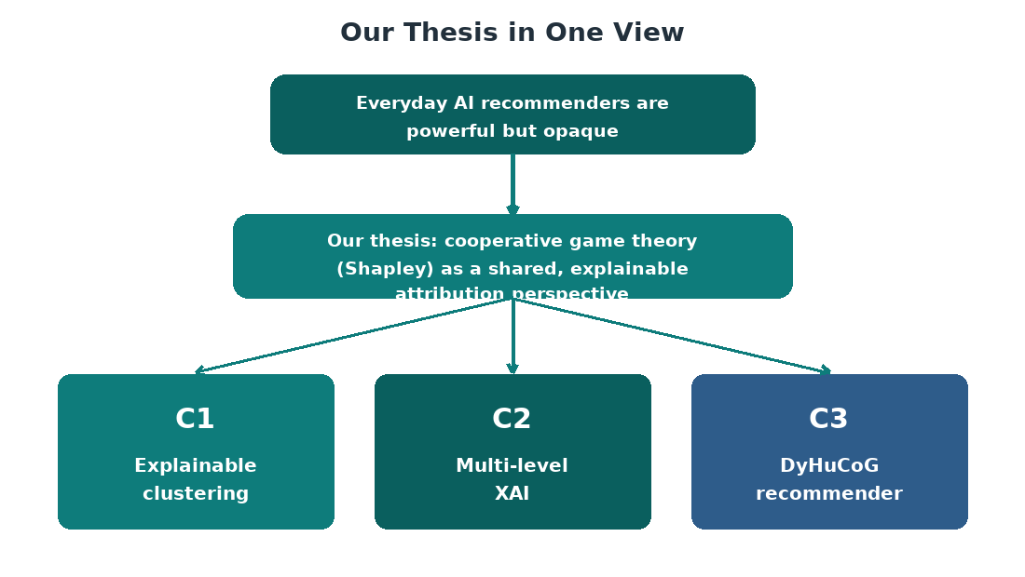
Our Thesis
Paradigms
Problematic
Contributions
▪ Thesis: cooperative game theory (Shapley) is one shared, explainable attribution perspective.
▪ The same logic spans clustering and recommendation:
– C1 – explains black-box clustering faithfully (wine).
– C2 – keeps explanation coherent under scale and hierarchy (Beijing).
– C3 – DyHuCoG turns attribution into an in-training signal.
▪ From post-hoc description to in-training guidance.
PhD Viva – Mouad LOUHICHI – Cooperative Game Theory & Shapley for XAI in Recommendation Systems
Notes:
Our thesis is a single claim: that Shapley-value attribution can function as one shared, explainable perspective spanning clustering and recommendation. The three contributions are not separate fixes but one cumulative argument — each applies the same cooperative-game logic to a different stage, from faithful clustering explanation to an in-training signal inside a recommender. That is what makes explanation part of the modelling logic itself, not a by-product attached after prediction.

Slide 15
Experimental Protocol
PhD Viva – Mouad LOUHICHI – Cooperative Game Theory & Shapley for XAI in Recommendation Systems
Notes:
Before the contributions, let me briefly cover the shared experimental setup. The purpose of this section is to establish that my comparisons are fair: the datasets, the splitting and preprocessing, the baselines, the evaluation metrics, and the hardware environment.

Slide 16
Datasets Used Throughout the Thesis
Datasets
Metrics
Hardware
Dataset | Scale | Type | Role
Wine Quality (vinho verde) | 4,898 × 11 | Tabular, numeric | C1 – single-level clustering
Beijing Multi-Site Air Quality | 383,585 × 11 | Tabular, pollutant + meteorology | C2 – multi-level clustering
MovieLens-1M | 6,040 u / 3,706 i / 1.0M int | Implicit feedback (0.0447) | C3 – DyHuCoG
Amazon-Book | 52,643 u / 91,599 i / 3.0M int | Implicit feedback (0.0006) | C3 – DyHuCoG
PhD Viva – Mouad LOUHICHI – Cooperative Game Theory & Shapley for XAI in Recommendation Systems
Notes:
Two clustering datasets and two recommendation datasets. For clustering I deliberately picked datasets with semantically interpretable features, because the whole point of the method is to return attribution to the original variables. Wine Quality is a small, dense, chemically correlated dataset of almost five thousand samples with eleven features. Beijing Multi-Site Air Quality is a large, noisy, temporally and meteorologically variable dataset of over three hundred and eighty thousand hourly records. For recommendation I used benchmark-standard datasets with established baselines: MovieLens-1M, with roughly a million interactions and a density of 0.0447, and Amazon-Book, which is far sparser at 0.0006. The sparsity contrast is deliberate, because it stress-tests whether a Shapley-guided model helps most precisely when interaction data are weak.

Slide 17
Dataset Characteristics & Why Each Was Chosen
Datasets
Metrics
Hardware
▪ Wine Quality – 11 interpretable physicochemical features; small, dense, chemically correlated → tests attribution in a trusted semantic space.
▪ Beijing Air Quality – 11 pollutant + meteorological variables, 383,585 hourly records → tests scale, noise and temporal/meteorological structure.
▪ MovieLens-1M – ~1.0M interactions, density 0.0447 → benchmark-standard recommendation with established baselines.
▪ Amazon-Book – ~3.0M interactions, density 0.0006 → deliberately sparse to stress-test Shapley weighting when signal is weak.
▪ The 0.0447 vs 0.0006 density contrast is intentional: the claim is that gains are largest where data are weakest.
PhD Viva – Mouad LOUHICHI – Cooperative Game Theory & Shapley for XAI in Recommendation Systems
Notes:
Beyond scale, each dataset was chosen so that attribution lands in a vocabulary a domain expert can act on. Wine and Beijing give semantically interpretable features (chemistry, pollution); the two recommenders give a density contrast that isolates whether cooperative attribution helps most when interaction data are scarce. That is why the same explanatory logic can be validated across tabular clustering and recommendation without changing the mechanism.

Slide 18
Data Splitting & Preprocessing
Datasets
Metrics
Hardware
▪ Clustering: five-fold cross-validation for surrogate/attribution stability.
▪ Recommendation: user-level, temporal split — 70% train / 10% val / 20% test.
▪ Leave-one-out: the latest test positive per user is the target, ranked against negatives.
▪ Implicit conversion: MovieLens-1M ratings > 3 treated as positive.
▪ Popularity-aware negative sampling: q(i) ∝ f_i^η for harder contrasts.
▪ Reproducibility: seeds {42,43,44,45,46}; early-stopping patience 20.
PhD Viva – Mouad LOUHICHI – Cooperative Game Theory & Shapley for XAI in Recommendation Systems
Notes:
Splitting is designed against leakage, because recommendation metrics are especially sensitive to how you split. For clustering I use five-fold cross-validation to test the stability of the surrogate and the attribution. For recommendation I use a user-level, temporal holdout: interactions sorted by time per user, split seventy percent train, ten percent validation, twenty percent test. Evaluation uses leave-one-out, where the latest test positive per user is the target, ranked against sampled negatives. Because MovieLens-1M contains explicit ratings, I convert ratings greater than three into positive implicit feedback. Negatives are drawn from a popularity-aware distribution to produce harder contrasts. Results are reported across five seeds, with early stopping on validation NDCG at twenty.

Slide 19
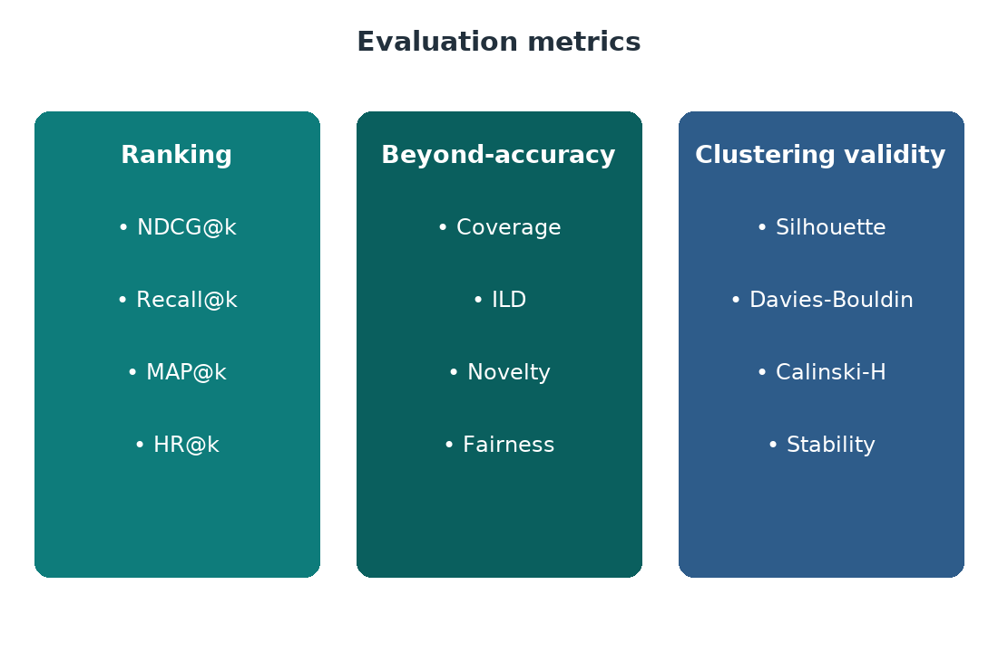
Baselines & Evaluation Metrics
Datasets
Metrics
Hardware
▪ Clustering benchmark: LIME-based surrogate explanation pipeline.
▪ Recommendation benchmarks: MF, NCF, LightGCN, RecDCL, HCCF, HPCF (strongest reference).
▪ Ranking: Precision@K, Recall@K, NDCG@20 (principal).
▪ System diversity: Catalogue Coverage = |⋃ R_u| / |I|.
▪ List diversity: Intra-List Diversity (ILD), built into the coalition utility.
▪ Clustering quality: Silhouette, Davies–Bouldin.
PhD Viva – Mouad LOUHICHI – Cooperative Game Theory & Shapley for XAI in Recommendation Systems
Notes:
Baselines span classical, neural, graph and hypergraph methods, precisely so that I can isolate the contribution of cooperative attribution rather than a favourable model choice. For recommendation I compare against matrix factorisation, NCF, LightGCN, RecDCL, HCCF and HPCF, treating HPCF as the strongest reference. For clustering interpretability I compare against a LIME-based surrogate pipeline. Ranking is measured with Precision at K, Recall at K and NDCG at twenty as the principal measure. On the diversity side I measure system-level catalogue coverage, and list-level intra-list diversity, defined as the average pairwise dissimilarity inside a ranked list. I want to emphasise that ILD is not decorative: it is deliberately built into the DyHuCoG coalition utility. Clustering quality is measured with Silhouette and Davies-Bouldin.

Slide 20
Hardware & Software
Datasets
Metrics
Hardware
▪ CPU: Intel Core i9-14900K, 24 cores — clustering, preprocessing, data loading.
▪ GPU: NVIDIA GeForce RTX 4090, 24 GB — DyHuCoG training & inference.
▪ RAM: 48 GB; Storage: 2 TB SSD.
▪ Python 3.8; scikit-learn, LightGBM, SHAP, PyTorch 2.0.1, NumPy/SciPy/pandas.
▪ Altair for interactive SHAP visualisation; metrics at K ∈ {5, 10, 20}.
PhD Viva – Mouad LOUHICHI – Cooperative Game Theory & Shapley for XAI in Recommendation Systems
Notes:
The hardware matters mainly because it explains some runtime figures I will quote later. All clustering, preprocessing and data loading run on an Intel Core i9-14900K with twenty-four cores. DyHuCoG training and inference run on an NVIDIA RTX 4090 with twenty-four gigabytes, alongside forty-eight gigabytes of RAM and a two-terabyte SSD. The software stack is Python 3.8, with scikit-learn for PCA and K-Means, LightGBM for the surrogate, SHAP for TreeSHAP, and PyTorch 2.0.1 for the recommendation model. I use Altair for interactive SHAP visualisation and report metrics at K equal to five, ten and twenty. Everything stays within ordinary academic compute; nothing here needs industrial infrastructure.

Slide 21
Contribution I — Explainable Black-Box Clustering
PhD Viva – Mouad LOUHICHI – Cooperative Game Theory & Shapley for XAI in Recommendation Systems
Notes:
Let us move to the first contribution: explaining black-box clustering with Shapley values. This contribution answers RQ1, and I will present it in four steps: objectives, methodology, results, findings.

Slide 22
Contribution I — Explainable Black-Box Clustering
Objectives
Methodology
Results
Findings
▪ Gap: Shapley explanation is dominant in supervised tasks, but clustering remains comparatively under-explained.
– Existing clustering-interpretability methods privilege local or global explanation, not both.
– They often fail to scale or preserve coherence across clusters.
▪ Objectives: build a pipeline yielding cluster-level explanation while preserving feature-level attribution.
– Preserve the semantics of the original feature space; justify why Shapley is better than LIME.
PhD Viva – Mouad LOUHICHI – Cooperative Game Theory & Shapley for XAI in Recommendation Systems
Notes:
Why start with clustering? Here the model creates its own structure, so cluster meaning must be inferred after the fact — which makes clustering the hardest and most natural test bed for attribution. The gap is that explainable clustering is fragmented: methods favour a local or a global explanation, rarely both; they often fail to scale; and they rarely preserve coherence across clusters. And because Shapley explanation is well established in supervised problems, its near absence from unsupervised clustering is striking. Our objectives are threefold: build a pipeline yielding a cluster-level explanation while preserving feature-level attribution; preserve the semantics of the original feature space rather than a transformed latent space; and justify why Shapley is the right concept rather than an ad-hoc surrogate such as LIME.

Slide 23
Contribution I — Explainable Black-Box Clustering
Objectives
Methodology
Results
Findings
▪ RQ1 · How can Shapley values explain black-box clustering faithfully at instance and cluster level?
– Objective O1 · Build a pipeline that yields cluster-level explanation while keeping feature-level attribution.
– Objective O2 · Preserve the semantics of the original feature space, not a reduced latent space.
– Objective O3 · Justify Shapley over an ad-hoc surrogate such as LIME.
PhD Viva – Mouad LOUHICHI – Cooperative Game Theory & Shapley for XAI in Recommendation Systems
Notes:
RQ1 asks how Shapley values can explain black-box clustering faithfully at both instance and cluster level, and it decomposes into three objectives. O1 is a pipeline that produces a cluster-level explanation while preserving feature-level attribution, so the explanation is coherent rather than a single summary number. O2 requires that attribution stays in the original feature space — density, pH, acidity, sulfur dioxide, alcohol — because that is what makes it actionable for a domain expert. O3 is a justificatory objective: we must show why Shapley is the right allocation rule rather than an ad-hoc surrogate such as LIME. The next methodology slide shows how these three objectives are met.

Slide 24
Contribution I — Explainable Black-Box Clustering
Objectives
Methodology
Results
Findings
▪ Player set N = F — each feature is a player.
▪ Value function v(S) = Silhouette( KMeans(X_S, k*) ) — how well data cluster using only features in S.
▪ A feature's Shapley value = its expected marginal contribution to clustering quality over all coalition orders.
▪ Why Silhouette: bounded, normalised, semantically intuitive.
▪ Direct evaluation for every coalition is intractable → we need a bridge.
PhD Viva – Mouad LOUHICHI – Cooperative Game Theory & Shapley for XAI in Recommendation Systems
Notes:
We frame clustering as a cooperative game where features are the players. The value function measures how well the data cluster when we use only the features in a given coalition: concretely, the value of coalition S is the Silhouette of K-Means run on the feature subset X_S, with a fixed k. I choose Silhouette because it is bounded, normalised and semantically intuitive; Davies-Bouldin or Calinski-Harabasz would also be defensible. A feature then receives a high Shapley value when its presence consistently improves separation across all coalitions, in expectation. The problem is that evaluating Silhouette for every subset is combinatorial and infeasible even for a modest number of features, which is exactly why we need a bridge between the unsupervised partition and a tractable attribution method.

Slide 25
Contribution I — Explainable Black-Box Clustering
Objectives
Methodology
Results
Findings
▪ Once K-Means produces cluster labels, train a LightGBM multiclass surrogate to predict them from original features.
▪ Apply TreeSHAP to the surrogate — fast, exact tree-based attribution in the original semantic feature space.
– Direct TreeSHAP on K-Means is impossible (it explains tree models, not centroids).
– The surrogate preserves the chemistry/pollution vocabulary that makes the analysis actionable.
– Validity condition: surrogate fidelity is high (macro-F1 ≈ 0.82).
PhD Viva – Mouad LOUHICHI – Cooperative Game Theory & Shapley for XAI in Recommendation Systems
Notes:
The bridge is the heart of the method. TreeSHAP explains tree models; it cannot explain K-Means centroids. And explaining the PCA representation would move attribution away from the interpretable variables we care about. So we convert an unsupervised partition into a supervised task: once K-Means produces cluster labels, we train a LightGBM multiclass classifier to predict them from the original features, then apply TreeSHAP to that surrogate. This keeps attribution in the original semantic feature space, which is what makes the explanation actionable. The key validity condition is surrogate fidelity: if the surrogate does not reproduce the partition well, the attribution is not faithful. We require a macro-F1 of around 0.82 as the floor.

Slide 26
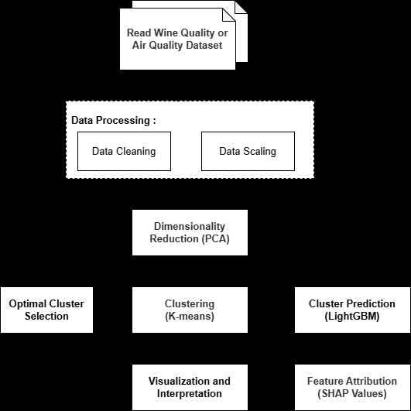
Contribution I — Explainable Black-Box Clustering
Objectives
Methodology
Results
Findings
▪ Stage 1 – PCA: stabilise geometry + visual diagnostic. NOT the explanatory space.
▪ Stage 2 – K-Means++ with multi-criteria k selection (elbow, Silhouette, Davies–Bouldin).
▪ Stage 3 – LightGBM surrogate trained on original features to predict cluster labels.
▪ Stage 4 – TreeSHAP attribution in the original feature space.
▪ Stage 5 – Aggregate into global importance, cluster-specific profiles, and local force plots.
– Complexity: dominated by PCA and repeated K-Means; TreeSHAP scales with tree count, not exponentially in features.
PhD Viva – Mouad LOUHICHI – Cooperative Game Theory & Shapley for XAI in Recommendation Systems
Notes:
The pipeline has five stages. Stage one is feature standardisation. Stage two is PCA, which I want to stress is used only as a computational and visual diagnostic; it is deliberately not the explanatory space, because explaining principal components would defeat the purpose of actionable attribution. Stage three is K-Means-plus-plus with multi-criteria k selection, drawing on the elbow method, Silhouette and Davies-Bouldin. Stage four is the LightGBM surrogate trained on the original features to predict cluster labels. Stage five is TreeSHAP attribution in the original feature space, aggregated into global importance, cluster-specific profiles, and local force plots. Complexity is dominated by PCA and repeated K-Means; TreeSHAP scales with tree count and depth rather than exponentially in features, which is what makes the approach tractable.

Slide 27
Contribution I — Explainable Black-Box Clustering
Objectives
Methodology
Results
Findings
▪ Multi-criteria evaluation across k ∈ {2..10} using elbow, Silhouette, Davies–Bouldin.
▪ We select k* = 3 — even though it is NOT geometrically optimal:
– k = 2: Silhouette 0.214, Davies–Bouldin 1.775 (better separation).
– k = 3: Silhouette 0.144, Davies–Bouldin 2.097 (weaker separation).
– Why: three clusters give a semantically richer oenological partition → more actionable.
– Note: the higher Silhouette ≈ 0.63 belongs to Beijing (C2), not this wine partition.
PhD Viva – Mouad LOUHICHI – Cooperative Game Theory & Shapley for XAI in Recommendation Systems
Notes:
This is an honest and important point. We evaluate k from two to ten, and deliberately select k equal to three even though it is not geometrically optimal. With k equal to two we get a stronger Silhouette of 0.214 and a Davies-Bouldin of 1.775; with k equal to three the Silhouette drops to 0.144 and the Davies-Bouldin rises to 2.097. On raw geometry, two is the better partition. We choose three nonetheless, because three clusters support three distinct, chemically meaningful oenological narratives, far more actionable than a dichotomous split. I select the partition a domain expert would find useful, not the one that maximises a separation index. And to avoid a common confusion: the 0.63 Silhouette belongs to the Beijing dataset in Contribution II, not this one.

Slide 28
Contribution I — Explainable Black-Box Clustering
Objectives
Methodology
Results
Findings
▪ Global SHAP ranking (high → low):
– density → pH → fixed acidity → sulfur-dioxide → alcohol
– Dominant drivers relate to structure, preservation, and sensory balance.
– This is NOT an arbitrary classifier artefact — it recovers a chemically interpretable hierarchy.
PhD Viva – Mouad LOUHICHI – Cooperative Game Theory & Shapley for XAI in Recommendation Systems
Notes:
The global SHAP ranking is dominated by density, followed by pH, fixed acidity, sulfur-dioxide-related variables and alcohol. These are precisely the variables that an oenologist would point to as governing structure, preservation and sensory balance. The important point is that this is not an arbitrary classifier artefact. Because the surrogate was trained to reproduce the partition from the original variables, and because TreeSHAP attributes in that original space, the recovered hierarchy corresponds to a chemically interpretable structure. This is the strongest evidence that the pipeline is faithful: it recovers domain knowledge without being told to. It also illustrates the value of keeping attribution in the semantic feature space rather than in a reduced or latent space.

Slide 29
Contribution I — Explainable Black-Box Clustering
Objectives
Methodology
Results
Findings
▪ Three clusters show distinct explanatory signatures.
– Cluster 0 – density + sulfur-dioxide-related variables.
– Cluster 1 – acidity and pH-related effects.
– Cluster 2 – a different balance of acidity, alcohol, and related chemical attributes.
– The same small set of variables recurs across clusters, with different relative weights within each.
PhD Viva – Mouad LOUHICHI – Cooperative Game Theory & Shapley for XAI in Recommendation Systems
Notes:
The cluster-specific profiles show that the solution is not only globally interpretable but internally differentiated. Each cluster exhibits a distinct signature. Cluster zero is driven primarily by density and sulfur-dioxide-related variables; cluster one by acidity and pH effects; cluster two by a different balance across acidity, alcohol and related chemical attributes. Crucially, the same small set of variables recurs across all three clusters, but with different relative weights within each. This is the actionable insight: a cluster is not just a label, it is a distinct, domain-meaningful combination of drivers. It also shows the method supports both a global reading, which variable matters most overall, and a local, per-cluster reading, where the practical value lies.

Slide 30
Contribution I — Explainable Black-Box Clustering
Objectives
Methodology
Results
Findings
Criterion | SHAP (cooperative) | LIME (local surrogate)
Basis | Cooperative-game marginal contribution | Local surrogate approximation
Local / global | Both | Primarily local
Theoretical guarantee | Efficiency, symmetry, null player, additivity | None equivalent
Stability | Higher when surrogate faithful | Sensitive to perturbation design
Cluster comparison | Strong | Limited
PhD Viva – Mouad LOUHICHI – Cooperative Game Theory & Shapley for XAI in Recommendation Systems
Notes:
This table summarises why we prefer Shapley over LIME. SHAP grounds attribution in a cooperative-game allocation rule and satisfies four axioms: efficiency, so explanatory mass is fully allocated; symmetry, so equal marginal contributors get equal credit; the null-player property, so zero marginal contributors get zero; and additivity, so explanations compose. LIME fits a local surrogate and has no equivalent guarantee; it is sensitive to perturbation design. SHAP supports both local and global explanation, whereas LIME is primarily local, and SHAP is much stronger for comparing clusters, which is central here. One caveat: in this surrogate pipeline, efficiency holds with respect to the LightGBM output, not directly to the Silhouette-based game. That is exactly why surrogate fidelity matters.

Slide 31
Contribution I — Explainable Black-Box Clustering
Objectives
Methodology
Results
Findings
▪ Answers to the questions and objectives
– RQ1 answered in the affirmative — faithful, coherent cluster-level explanation from Shapley values.
– O1 met · cluster-level explanation while preserving feature-level attribution.
– O2 met · attribution returned to the original chemical variables.
– O3 met · Shapley grounded in four axioms; LIME has no equivalent guarantee.
PhD Viva – Mouad LOUHICHI – Cooperative Game Theory & Shapley for XAI in Recommendation Systems
Notes:
To answer RQ1 directly: yes. Shapley values explain a black-box partition faithfully, provided the surrogate is high-fidelity, and coherently at cluster level. Each objective is met. O1 is met because the pipeline yields both a global reading — density, pH, acidity, sulfur dioxide, alcohol — and a per-cluster reading where the same drivers re-weigh differently. O2 is met because attribution is returned to the original chemical variables, which is what makes it actionable. O3 is met because Shapley satisfies efficiency, symmetry, the null-player property and additivity, whereas LIME has no equivalent guarantee. The honest caveat is that efficiency holds with respect to the surrogate output, not directly to the Silhouette-based game — which is why surrogate fidelity is the critical validity condition.

Slide 32
Contribution I — Explainable Black-Box Clustering
Objectives
Methodology
Results
Findings
▪ Key findings
– Cluster-level explanation anchored to individual feature contributions.
– Explanations returned to the original chemical variables, not a latent space.
– Theoretically grounded case for Shapley over LIME (efficiency, symmetry, null player, additivity).
– Recovers an oenologically interpretable ranking — density, pH, acidity, sulfur dioxide, alcohol.
PhD Viva – Mouad LOUHICHI – Cooperative Game Theory & Shapley for XAI in Recommendation Systems
Notes:
C1 answers RQ1 in the affirmative. The key findings are fourfold. Shapley values explain the black-box partition at both cluster level and instance level, anchoring each cluster's meaning to individual feature contributions. They return attribution to the original chemical variables — density, pH, fixed acidity, sulfur dioxide, alcohol — rather than to a reduced or latent space, which is what makes the explanation actionable. Because the surrogate reproduces the partition from the original variables, the recovered ranking is chemically interpretable and faithful. And the approach is theoretically grounded: SHAP satisfies efficiency, symmetry, the null-player property and additivity, which LIME does not.

Slide 33
Contribution I — Explainable Black-Box Clustering
Objectives
Methodology
Results
Findings
▪ Limitations
– Fidelity depends on the LightGBM surrogate — not a direct mechanism of the K-Means geometry.
– Confined to tabular data; no structured, graph, or image input.
– Single-level structure: cannot explain how importance reconfigures between a partition and its sub-partitions.
– The surrogate approximation compresses observation-level variation.
PhD Viva – Mouad LOUHICHI – Cooperative Game Theory & Shapley for XAI in Recommendation Systems
Notes:
Let me be clear about the scope. First, the explanation depends on the fidelity of the LightGBM surrogate; it is not a direct mechanism of the K-Means geometry. Second, the approach is confined to tabular data. Third, and most importantly for what follows, it is single-level: it cannot yet address hierarchical coherence, meaning it cannot explain how feature importance reconfigures between a partition and its sub-partitions. And the surrogate plus representative-instance reporting compresses some observation-level variation. These limits define the point of departure for Contribution II.

Slide 34
Contribution I — Explainable Black-Box Clustering
Objectives
Methodology
Results
Findings
▪ Takeaways
– Shapley attribution is a single, principled lens for explaining an unsupervised partition.
– Keeping attribution in the original feature space is what makes it actionable.
– But real data are rarely single-level: broad regimes contain nested sub-groups.
▪ So the next question is whether this logic survives scale and hierarchy.
PhD Viva – Mouad LOUHICHI – Cooperative Game Theory & Shapley for XAI in Recommendation Systems
Notes:
The takeaway is that Shapley attribution works as a single, principled lens for explaining an unsupervised partition, and that keeping attribution in the original feature space is what makes it actionable. But real data are rarely single-level: broad regimes contain nested sub-groups, and a variable can be globally important yet locally uninformative. That flat limitation directly motivates Contribution II: can the explanation logic be scaled to multi-level, large-scale clustering without losing coherence?

Slide 35
Contribution II — Enhanced Multi-Level XAI for Large-Scale Clustering
PhD Viva – Mouad LOUHICHI – Cooperative Game Theory & Shapley for XAI in Recommendation Systems
Notes:
This brings us to the second contribution: scaling the explanation logic to multi-level, large-scale clustering. It answers RQ2, and the central concern is not merely scale but multi-granularity.

Slide 36
Contribution II — Multi-Level XAI for Large-Scale Clustering
Objectives
Methodology
Results
Findings
▪ Gap: once clustering is multi-level, feature importance must stay interpretable within a cluster, across sub-clusters, and across the hierarchy.
– Large-scale data make exact explanation computationally burdensome.
– Flat explanation may be true yet incomplete — it cannot show how importance changes inside a cluster.
▪ Objectives: a genuinely multi-level workflow; a formal cross-level consistency argument (Prop. 6.1); validation on a structurally different large-scale dataset.
PhD Viva – Mouad LOUHICHI – Cooperative Game Theory & Shapley for XAI in Recommendation Systems
Notes:
C2 asks whether the C1 logic survives scale and hierarchy. Large real-world data contain structure at more than one granularity: broad regimes at the top, nested sub-groups within them. A variable can be globally important yet locally uninformative, or the reverse, so a flat explanation is true but incomplete — it cannot show how importance reconfigures as you zoom in. The chapter adds three things. First, a genuine multi-level workflow, not a rerun of the single-level pipeline. Second, a formal cross-level consistency argument, Proposition 6.1, so that differences across levels can be interpreted rather than dismissed as inconsistency. Third, validation on a structurally different large-scale dataset, Beijing air quality, testing whether the method generalises beyond the small, correlated wine dataset.

Slide 37
Contribution II — Multi-Level XAI for Large-Scale Clustering
Objectives
Methodology
Results
Findings
▪ RQ2 · How can this extend to large-scale, hierarchical clustering without losing tractability or consistency?
– Objective O1 · A genuinely multi-level workflow, not a rerun of the single-level pipeline.
– Objective O2 · A formal cross-level consistency argument (Proposition 6.1).
– Objective O3 · Validation on a structurally different large-scale dataset.
PhD Viva – Mouad LOUHICHI – Cooperative Game Theory & Shapley for XAI in Recommendation Systems
Notes:
RQ2 asks whether the C1 logic survives scale and hierarchy without losing tractability or consistency, and it decomposes into three objectives. O1 is a genuinely multi-level workflow: coarse clustering at the top and nested sub-groups within, so that attribution stays interpretable inside a cluster, across sub-clusters, and across the hierarchy. O2 is a formal cross-level consistency argument, Proposition 6.1, so that differences across levels can be interpreted rather than dismissed as inconsistency. O3 is an empirical check on generality: validation on a structurally different large-scale dataset, Beijing air quality, rather than the small, chemically correlated wine dataset.

Slide 38
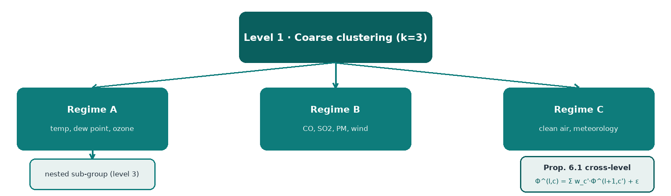
Contribution II — Multi-Level XAI for Large-Scale Clustering
Objectives
Methodology
Results
Findings
▪ Recursive/nested: coarse clustering on the full dataset, then subdivide each cluster.
▪ For each level, train a level-specific surrogate and compute SHAP in the SAME original feature space.
▪ Cross-level aggregation is NOT a naive average — it respects cluster size and nesting structure.
– Parent-level attribution = an expectation over the explanatory structure of its descendants.
– The hierarchy is a pragmatic analytical device, not a claim of true ontological hierarchy.
PhD Viva – Mouad LOUHICHI – Cooperative Game Theory & Shapley for XAI in Recommendation Systems
Notes:
The multi-level architecture proceeds recursively: we learn a coarse clustering on the full dataset, then subdivide each cluster where appropriate, producing a nested structure. For each level we train a level-specific surrogate and compute SHAP values in the same original feature space. The cross-level aggregation is deliberately not a naive average: it respects cluster size and nesting structure. A parent-level attribution is an expectation over the explanatory structure of its descendants, so a coarse-level importance reflects the size-weighted contributions of the clusters it contains. One methodological point: the hierarchy here is a pragmatic analytical device. I am not claiming the data have a true, ontological hierarchy of levels; the nested structure is a computational and interpretive tool, and Proposition 6.1 is stated with that in mind.

Slide 39
Contribution II — Multi-Level XAI for Large-Scale Clustering
Objectives
Methodology
Results
Findings
▪ Let Φ^(l,c)_j = E_{x~c}[|φ_j^(l)(x)|] be the expected absolute SHAP importance of feature j at level l in cluster c.
▪ Let w_c' = |c'| / |c| be the relative size of child c' within parent c.
▪ For a strict nested hierarchy on a consistent feature space:
– Φ^(l,c)_j = Σ_{c'∈child(c)} w_c' · Φ^(l+1,c')_j + ε_j
– ε_j is a residual from surrogate mismatch, vanishing under perfect fidelity.
– Derived via law of total expectation (children partition the parent).
– Does NOT imply explanations are identical across levels — it implies differences can be interpreted, not dismissed as inconsistency.
PhD Viva – Mouad LOUHICHI – Cooperative Game Theory & Shapley for XAI in Recommendation Systems
Notes:
Proposition 6.1 is the mathematical heart of the contribution. Let Phi at level l in cluster c for feature j be the expected absolute SHAP importance over examples in that cluster, and let w sub c-prime be the relative size of a child cluster within its parent. For a strict nested hierarchy on a consistent feature space, the parent's expected absolute importance equals the sum over its children of the child's relative size times the child's expected absolute importance, plus a residual epsilon that comes from surrogate mismatch and vanishes under perfect fidelity. The derivation uses the law of total expectation and the fact that children partition the parent. Crucially, it does not claim explanations are identical across levels; it says differences can be interpreted rather than dismissed as inconsistency. That makes a hierarchical explanation self-consistent and auditable.

Slide 40
Contribution II — Multi-Level XAI for Large-Scale Clustering
Objectives
Methodology
Results
Findings
▪ Full dataset, k = 3 (strong convergence on multi-criteria evaluation).
– Silhouette ≈ 0.63 — materially stronger separation than wine.
– Davies–Bouldin ≈ 0.55 — low between-cluster ambiguity.
– PCA projection (2 components) used only for visual inspection.
– Sensitivity: robust to modest variation in k, projection dim, surrogate depth; only low-ranked variables shift.
PhD Viva – Mouad LOUHICHI – Cooperative Game Theory & Shapley for XAI in Recommendation Systems
Notes:
On Beijing, the multi-criteria evaluation converges much more strongly than on wine, and this is worth emphasising. The full dataset clusters cleanly into k equal to three, with a Silhouette of about 0.63 and a Davies-Bouldin of about 0.55. Recall that this is where the 0.63 figure comes from — it belongs to Beijing, not to the wine partition, whose Silhouette is 0.144. The low Davies-Bouldin indicates little between-cluster ambiguity. The PCA projection, using two components, is used only for visual inspection. I also tested sensitivity: the conclusions are robust to modest variation in k, in the number of projection dimensions, and in the surrogate depth; only low-ranked variables shift. So the finding is not an artefact of a particular parameter choice.

Slide 41
Contribution II — Multi-Level XAI for Large-Scale Clustering
Objectives
Methodology
Results
Findings
▪ Global SHAP ranking (high → low):
– temperature → dew point → pressure → CO → NO2 → PM10 → PM2.5
– It is NOT simply pollutant concentrations that matter — meteorological variables play a structurally central role.
– Temperature, dew point and pressure condition dispersion, trapping, and photochemical behaviour.
– This is the kind of insight flat descriptive summaries often fail to make explicit.
PhD Viva – Mouad LOUHICHI – Cooperative Game Theory & Shapley for XAI in Recommendation Systems
Notes:
The global ranking is analytically rich. The dominant features are temperature, dew point and pressure, followed by carbon monoxide, nitrogen dioxide, PM10 and PM2.5. It is striking that it is not simply the pollutant concentrations that dominate. Meteorological variables play a structurally central role, because temperature, dew point and pressure condition dispersion, trapping and photochemical behaviour. In other words, they determine the atmospheric conditions under which pollution accumulates. This is exactly the kind of insight that flat, descriptive summaries often fail to make explicit: a naive ranking of pollutant concentrations would overlook the fact that the weather is what sets the regime. It is a good illustration of why attribution in the original variable space is valuable.

Slide 42
Contribution II — Multi-Level XAI for Large-Scale Clustering
Objectives
Methodology
Results
Findings
▪ Regime A – warm photochemical: ozone, temperature, dew point prominent (summer photochemical smog).
▪ Regime B – wintertime smog: CO, SO2, PM dominate; low wind speed suppresses dispersion.
▪ Regime C – comparatively clean air: favourable meteorology, weak pollutant pushes.
– The framework shows not only that these regimes exist, but which variable combinations define them.
PhD Viva – Mouad LOUHICHI – Cooperative Game Theory & Shapley for XAI in Recommendation Systems
Notes:
The force plots reveal three representative regimes, and this is where the interpretation becomes concrete. Regime A is a warm, photochemical regime, where ozone, temperature and dew point are prominent — this is characteristic of summer photochemical smog. Regime B is a wintertime smog regime, dominated by carbon monoxide, sulfur dioxide and particulate matter, with low wind speed suppressing dispersion. Regime C is a comparatively clean-air regime, associated with favourable meteorology and weak pollutant pushes. The interpretative value is not merely showing that these regimes exist — it is showing which combinations of variables define each one. That is the actionable insight: an air-quality analyst can see the specific drivers of a given pollution episode and act on them.

Slide 43
Contribution II — Multi-Level XAI for Large-Scale Clustering
Objectives
Methodology
Results
Findings
▪ At the coarse level, temperature and dew point dominate — they differentiate broad atmospheric regimes.
▪ Within individual clusters, CO, SO2, PM10, wind speed, pressure, or ozone become more discriminative.
▪ This change is NOT contradictory — it is exactly what a multi-level explanation should reveal.
– Parent-level story = regime selection. Cluster-level story = variation within a regime.
– A variable can be globally important yet locally uninformative within a sub-cluster.
PhD Viva – Mouad LOUHICHI – Cooperative Game Theory & Shapley for XAI in Recommendation Systems
Notes:
This is the conceptual payoff of the chapter, and the reason a flat explanation is insufficient. At the coarse level, temperature and dew point dominate, because they differentiate broad atmospheric regimes. Within individual clusters, the discriminative variables shift to carbon monoxide, sulfur dioxide, PM10, wind speed, pressure or ozone. This change is not a contradiction — it is exactly what a multi-level explanation should reveal. The parent-level story is regime selection; the cluster-level story is variation within a regime. A variable can be globally important yet locally uninformative within a sub-cluster. Proposition 6.1 lets us interpret these shifts as meaningful structure rather than noise; a flat, single-level explanation would present them as conflicting, whereas our framework makes them coherent.

Slide 44
Contribution II — Multi-Level XAI for Large-Scale Clustering
Objectives
Methodology
Results
Findings
▪ Wine: small, dense, chemically correlated. Beijing: large, noisy, temporally and meteorologically variable.
▪ The same explanatory logic remains productive in both → not tied to one domain-specific peculiarity.
– vs SHAP-based clustering literature: Beijing Silhouette ≈ 0.63 vs Gramegna & Giudici credit-risk 0.37.
– LIME comparator: weaker structural coherence, less stable local narratives for hierarchical reasoning.
PhD Viva – Mouad LOUHICHI – Cooperative Game Theory & Shapley for XAI in Recommendation Systems
Notes:
The same logic works on both a small, dense, chemically correlated dataset and a large, noisy, environmentally variable one, which supports the generality of the approach. It is not tied to a domain-specific peculiarity of wine chemistry. I also compared against the SHAP-based clustering literature: our Beijing partition achieves a Silhouette of about 0.63, whereas Gramegna and Giudici, working on credit-risk data, report around 0.37. On the LIME comparator, we observe weaker structural coherence and less stable local narratives for hierarchical reasoning. I want to be careful here: these are comparative observations rather than a comprehensive benchmark, but they support the claim that a cooperative-attribution approach produces more structured, more coherent explanations for hierarchical clustering.

Slide 45
Contribution II — Multi-Level XAI for Large-Scale Clustering
Objectives
Methodology
Results
Findings
▪ Answers to the questions and objectives
– RQ2 answered in the affirmative, with bounds — coherence retained under scale and hierarchy.
– O1 met · a multi-granular explanation that does not collapse into a single flat summary.
– O2 met · Proposition 6.1 provides a formal cross-level consistency argument.
– O3 met · validated on a structurally different large-scale dataset (Beijing air quality).
PhD Viva – Mouad LOUHICHI – Cooperative Game Theory & Shapley for XAI in Recommendation Systems
Notes:
To answer RQ2 directly: yes, with bounds. Shapley-based clustering explanation can scale to hierarchical, large-scale settings without losing interpretive coherence, provided the hierarchy is modelled explicitly and the approximation is transparent. O1 is met: we obtain a multi-granular explanation that does not collapse into a single flat summary. O2 is met: Proposition 6.1 gives a formal cross-level consistency argument, so regime-level and cluster-level stories are not at odds. O3 is met: the approach validates on Beijing air quality, a large, noisy, temporally variable dataset, which supports generality. The honest bound is that the model is still an explanation of a pre-computed partition; it does not yet influence learning itself. That is the bridge to Contribution III.

Slide 46
Contribution II — Multi-Level XAI for Large-Scale Clustering
Objectives
Methodology
Results
Findings
▪ Key findings
– Scalable, multi-granular explanation that does not collapse into a single flat summary.
– Formal cross-level consistency argument (Proposition 6.1).
– Validated on a structurally different large-scale dataset (Beijing air quality).
– Differences across levels are interpretable, not dismissed as inconsistency.
PhD Viva – Mouad LOUHICHI – Cooperative Game Theory & Shapley for XAI in Recommendation Systems
Notes:
C2 answers RQ2 in the affirmative. The key findings are fourfold. The explanation scales to a multi-granular structure without collapsing into a single flat summary, because the hierarchy is modelled explicitly rather than flattened. Proposition 6.1 provides a formal cross-level consistency argument, so that differences across levels can be interpreted as meaningful structure rather than dismissed as noise. The approach generalises to a structurally different large-scale dataset, Beijing air quality, which is far noisier and more temporally variable than the small correlated wine data. And the method produces parent-level regime-selection stories alongside cluster-level within-regime variation.

Slide 47
Contribution II — Multi-Level XAI for Large-Scale Clustering
Objectives
Methodology
Results
Findings
▪ Limitations
– Clustering remains static, even though the Beijing data are temporal.
– Surrogate-based SHAP plus representative-instance reporting compress observation-level variation.
– Confined to tabular data.
– Still an explanation of a pre-computed partition — it does not influence learning.
PhD Viva – Mouad LOUHICHI – Cooperative Game Theory & Shapley for XAI in Recommendation Systems
Notes:
The limitations are equally clear. The clustering remains static even though the Beijing data are temporal, so the dynamics are not exploited. The surrogate-based SHAP plus representative-instance reporting compresses observation-level variation, so some richness is lost. The whole approach is confined to tabular data. And, most importantly for what follows, the model is still an explanation of a pre-computed partition: it does not yet influence learning itself. This is the bridge to Contribution III.

Slide 48
Contribution II — Multi-Level XAI for Large-Scale Clustering
Objectives
Methodology
Results
Findings
▪ Takeaways
– Shapley attribution stays coherent across granularity — when the hierarchy is explicit.
– Explanations become interpretable against scale, not just against a single flat partition.
– But the attribution is still post-hoc: it explains a partition that was already computed.
▪ So the next step is to let attribution shape the learning itself.
PhD Viva – Mouad LOUHICHI – Cooperative Game Theory & Shapley for XAI in Recommendation Systems
Notes:
The takeaway is that Shapley attribution stays coherent across granularity, provided the hierarchy is made explicit. Explanations become interpretable against scale, not just against a single flat partition, which is precisely where the literature was weakest. But the attribution is still post-hoc: it explains a partition that was already computed, and it never influences how the model learns. That is the limit that motivates Contribution III — can cooperative attribution move beyond explanation and enter the learning dynamics of a recommender?

Slide 49
Contribution III — DyHuCoG: A Dynamic Hypergraph Cooperative Game
PhD Viva – Mouad LOUHICHI – Cooperative Game Theory & Shapley for XAI in Recommendation Systems
Notes:
The third and principal contribution introduces DyHuCoG, a Dynamic Hypergraph Cooperative Game, where Shapley attribution becomes an in-training signal inside a hypergraph recommender rather than a post-hoc explanation. It answers RQ3 and RQ4.

Slide 50
Contribution III — DyHuCoG: A Dynamic Hypergraph Cooperative Game
Objectives
Methodology
Results
Findings
▪ Gap: graph and hypergraph recommenders treat message importance as either uniform or attention-weighted, without a principled marginal-contribution account.
– Diversity is often a secondary objective or a re-ranking heuristic.
– Interpretability is added after prediction, not integrated into the learning objective.
▪ Objectives: formulate recommendation as a cooperative game; embed preference-aware Monte Carlo Shapley into message passing; improve ranking, coverage, and diversity jointly.
PhD Viva – Mouad LOUHICHI – Cooperative Game Theory & Shapley for XAI in Recommendation Systems
Notes:
C3 is the flagship contribution and the conceptual shift of the whole thesis. The gap is that graph and hypergraph recommenders treat message importance as either uniform or attention-weighted, without a principled account of marginal contribution. Diversity is typically a secondary objective or a re-ranking heuristic, not part of the core learning problem; and interpretability is added after prediction rather than integrated into the objective. Our objectives are threefold: formulate recommendation as a cooperative game in which users, items and contexts are players; embed preference-aware Monte Carlo Shapley estimates into hypergraph message passing so that attribution directly shapes how information flows; and improve ranking accuracy, coverage and intra-list diversity jointly. The strongest claim is not that we explain a recommender; it is that attribution becomes an in-training signal.

Slide 51
Contribution III — DyHuCoG: A Dynamic Hypergraph Cooperative Game
Objectives
Methodology
Results
Findings
▪ RQ3 · Can cooperative attribution move beyond post-hoc and enter the learning dynamics of graph recommenders?
– RQ4 · Can a recommender jointly optimise ranking accuracy, context and diversity when importance is estimated by a cooperative-game utility?
– Objective O1 · Formulate recommendation as a cooperative game with users, items and contexts as players.
– Objective O2 · Embed preference-aware Monte Carlo Shapley into hypergraph message passing.
– Objective O3 · Improve ranking, coverage and diversity jointly.
PhD Viva – Mouad LOUHICHI – Cooperative Game Theory & Shapley for XAI in Recommendation Systems
Notes:
C3 answers RQ3 and RQ4 together, and it is the conceptual shift of the thesis. RQ3 asks whether cooperative attribution can move beyond post-hoc explanation and enter the learning dynamics of a graph recommender. RQ4 asks whether a recommender can jointly optimise ranking accuracy, context and diversity when importance is estimated by a cooperative-game utility. Both map to three objectives. O1 is to formulate recommendation as a cooperative game in which users, items and contexts are players. O2 is to embed preference-aware Monte Carlo Shapley estimates into hypergraph message passing, so attribution directly shapes how information flows. O3 is to improve ranking, coverage and intra-list diversity jointly — not at the expense of one another.

Slide 52
Contribution III — DyHuCoG: A Dynamic Hypergraph Cooperative Game
Objectives
Methodology
Results
Findings
▪ Player set N = U ∪ I ∪ C (users, items, contexts).
▪ Hypergraph H = (V, E, W); V = U ∪ I ∪ C; W = dynamic edge weights from Shapley estimates.
▪ Coalition S ⊆ N represents entities participating in a recommendation episode.
▪ Coalition value v(S) measures the quality of the recommendation outcome achievable by S.
▪ Top-N task: produce a ranked list L_u balancing relevance, diversity, and contextual fit.
PhD Viva – Mouad LOUHICHI – Cooperative Game Theory & Shapley for XAI in Recommendation Systems
Notes:
We model recommendation as a cooperative game whose players are users, items and contexts. The hypergraph has vertices drawn from this same set, and hyperedges encode user-item-context interactions, with dynamic edge weights derived from Shapley estimates. A coalition represents the entities participating in a recommendation episode, and the coalition value measures the quality of the recommendation outcome achievable by that coalition. The task is top-N recommendation: we produce a ranked list for a user that balances relevance, diversity and contextual fit. This parallels the clustering formulation, but with a value function that is recommendation-oriented. That parallelism is deliberate and is one of the thesis-level contributions: the same cooperative-game logic applies to both tasks.

Slide 53
Contribution III — DyHuCoG: A Dynamic Hypergraph Cooperative Game
Objectives
Methodology
Results
Findings
▪ v(S) = α · NDCG@20(S) + β · Diversity(S) + γ · ContextScore(S), with α + β + γ = 1.
– The same trade-off the recommender must satisfy is the trade-off from which attribution is computed — explanatory game and predictive objective are aligned by design.
▪ Preference-weighted: v_pref(S) = v(S) + λ_pref · Σ_{(u,i)∈S} sim(u,i).
– α = 0.60, β = 0.25, γ = 0.15; λ_pref = 0.20 — grid-searched, stable (<1.5% variance in NDCG@20).
– Coalition evaluation scoped to the interaction episode (a few dozen players), not the full catalogue.
PhD Viva – Mouad LOUHICHI – Cooperative Game Theory & Shapley for XAI in Recommendation Systems
Notes:
The coalition utility combines ranking quality, diversity and context: a weighted sum of NDCG at twenty, a diversity term and a context score, with weights summing to one. The key point is that this is the same trade-off the recommender must satisfy and also the trade-off from which attribution is computed, so the explanatory game and the predictive objective are aligned by design. We add a preference-consistency bonus proportional to the sum of user-item similarities in the coalition. Alpha, beta, gamma were grid-searched to 0.60, 0.25, 0.15, with the preference coefficient at 0.20 and NDCG varying by under one and a half percent. One honest boundary: coalition evaluation is scoped to the interaction episode, a few dozen players, not the full catalogue.

Slide 54
Contribution III — DyHuCoG: A Dynamic Hypergraph Cooperative Game
Objectives
Methodology
Results
Findings
▪ Exact Shapley is combinatorial and infeasible for realistic systems.
▪ Monte Carlo estimator: φ̂_j = (1/M) Σ_m [ v(S_m ∪ {j}) − v(S_m) ].
▪ Preference-aware: φ̂_j^pref = (1/M) Σ_m [ v_pref(S_m ∪ {j}) − v_pref(S_m) ].
– Unbiased; variance = σ²/M → MSE decays O(1/M), absolute error O(1/√M).
– M = 50 selected: MSE ≈ 1.4×10⁻⁵, ~99% accuracy on MovieLens-1M.
– Refreshed every 10 batches (~49 updates/epoch), smoothed by exponential moving average.
PhD Viva – Mouad LOUHICHI – Cooperative Game Theory & Shapley for XAI in Recommendation Systems
Notes:
Exact Shapley computation is combinatorial and infeasible for a realistic recommender, so we use a Monte Carlo estimator that averages, over M sampled coalitions, the difference between the value including a player and the value excluding it; the preference-aware variant applies the same estimator to the preference-weighted utility. It is unbiased, with variance decaying as sigma squared over M, so mean squared error goes as one over M and absolute error as one over root M. We chose M equal to fifty: mean squared error about one point four times ten to the minus five, and roughly ninety-nine percent accuracy. Because preferences evolve, estimates are refreshed every ten batches, about forty-nine updates per epoch, and smoothed with an exponential moving average, so attribution is adaptive without making training hypersensitive to a single estimate.

Slide 55
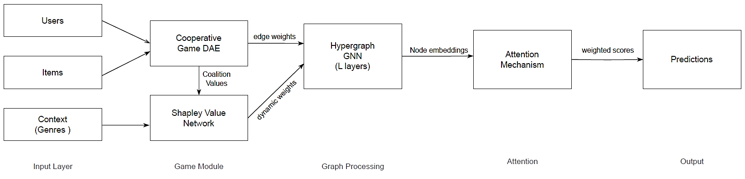
Contribution III — DyHuCoG: A Dynamic Hypergraph Cooperative Game
Objectives
Methodology
Results
Findings
▪ Base propagation: e^(l+1) = σ( D^-1/2 A D^-1/2 e^(l) ).
▪ Shapley-weighted: e_j^(l+1) = σ( W^(l) e_j^(l) + Σ_{k∈N(j)} w_jk e_k^(l) ).
▪ Normalised weights: w_jk = φ̂_jk / Σ_{k'∈N(j)} φ̂_jk'.
– Clipped + exponentially smoothed before normalisation (stabilises sparse regimes).
– Attention gate: a_ui = σ( W_a[ e_u, e_i, l_i ] ); y_ui = (1 + a_ui) ⟨e_u, e_i⟩.
– Context-aware score: f(u,i,c) = y_ui + λ_c ⟨g(c_ui), e_cui⟩.
PhD Viva – Mouad LOUHICHI – Cooperative Game Theory & Shapley for XAI in Recommendation Systems
Notes:
The architecture is the decisive move. The base propagation is standard hypergraph message passing; the Shapley-weighted version weights each message by a normalised Shapley coefficient, dividing by the sum of coefficients over the neighbourhood. I clip and exponentially smooth the estimates before normalising, which stabilises the sparse regime. Layer fusion combines embeddings across layers with learned coefficients. On top of that, an interaction-level attention gate interpolates between the Shapley-weighted score and the standard inner-product score, acting as a stabiliser; a context-aware score then adds a context term. The essential point is that the model is told not only who is connected to whom, but how much each coalition is worth, and that worth directly governs how information propagates. That is what distinguishes it from a post-hoc explainer.

Slide 56
Contribution III — DyHuCoG: A Dynamic Hypergraph Cooperative Game
Objectives
Methodology
Results
Findings
▪ L = L_rec + λ_div L_div + λ_ctx L_ctx + λ_reg L_reg.
– L_rec – Bayesian Personalised Ranking (pairwise, implicit feedback).
– L_div – Intra-List Diversity regulariser: penalises redundant ranked lists.
– L_ctx – Context alignment: match context embedding to context-node representation.
– L_reg – L2 weight decay.
– The learning objective and coalition value are aligned: DyHuCoG trains to optimise the same balance that later determines attribution.
PhD Viva – Mouad LOUHICHI – Cooperative Game Theory & Shapley for XAI in Recommendation Systems
Notes:
The composite loss combines four terms. The recommendation loss is Bayesian Personalised Ranking, which is a pairwise objective appropriate for implicit feedback. The diversity loss is an intra-list diversity regulariser that penalises redundant ranked lists. The context loss aligns the context embedding with the context-node representation. And the regularisation term is weight decay. Negatives are drawn from a popularity-aware distribution, with periodic hard-negative refresh, and optimisation uses Adam. The conceptual point I want to drive home is alignment: the model is trained to optimise the same accuracy-diversity-context balance that later determines cooperative attribution. So the explanation is not a separate diagnostic; it is a direct read-out of the objective the model is already optimising. This is what gives the explanation its structural faithfulness.

Slide 57
Contribution III — DyHuCoG: A Dynamic Hypergraph Cooperative Game
Objectives
Methodology
Results
Findings
Dataset | Model | NDCG@20 | Recall@20 | Coverage | Diversity
MovieLens-1M | HPCF | 0.2528 | 0.2098 | 0.342 | 0.461
MovieLens-1M | DyHuCoG | 0.2775 | 0.2362 | 0.397 | 0.516
Amazon-Book | HPCF | 0.0270 | 0.0359 | 0.259 | 0.535
Amazon-Book | DyHuCoG | 0.0306 | 0.0417 | 0.336 | 0.602
PhD Viva – Mouad LOUHICHI – Cooperative Game Theory & Shapley for XAI in Recommendation Systems
Notes:
This is the headline result, and I would ask you to read it carefully because it shows ranking and diversity improving together. On MovieLens-1M, the strongest baseline HPCF achieves NDCG at twenty of 0.2528 and recall of 0.2098; DyHuCoG improves these to 0.2775 and 0.2362, plus nine point seven seven percent in NDCG and plus twelve point five eight percent in recall. At the same time, coverage rises from 0.342 to 0.397 and intra-list diversity from 0.461 to 0.516. On Amazon-Book, which is much sparser, the relative gains are larger: plus thirteen point three three percent NDCG and plus sixteen point one six percent recall, with coverage up by nearly thirty percent. The sparser the data, the larger the gain — precisely the pattern you would expect if Shapley-driven weighting is most valuable when signal is weak.

Slide 58
Contribution III — DyHuCoG: A Dynamic Hypergraph Cooperative Game
Objectives
Methodology
Results
Findings
Metric | MovieLens-1M | Amazon-Book
NDCG@20 | +9.77% | +13.33%
Recall@20 | +12.58% | +16.16%
Coverage | +16.1% | +29.7%
Intra-List Diversity | +11.9% | +12.5%
PhD Viva – Mouad LOUHICHI – Cooperative Game Theory & Shapley for XAI in Recommendation Systems
Notes:
This slide summarises the relative gains over the strongest baseline, and the key message is that DyHuCoG improves ranking accuracy, coverage and diversity simultaneously — it does not sacrifice one for the others. The largest relative gains appear on the sparser Amazon-Book dataset, consistent with the hypothesis that Shapley-guided weighting helps most precisely when interaction data are weak. Together these results are evidence that the accuracy-diversity trade-off, often treated as structurally fixed, is in fact negotiable if attribution is handled as a first-class part of the learning objective. NDCG up, recall up, coverage up, diversity up: that combination is the core empirical claim of the third contribution.

Slide 59
Contribution III — DyHuCoG: A Dynamic Hypergraph Cooperative Game
Objectives
Methodology
Results
Findings
▪ MovieLens-1M: Coverage 0.342 → 0.397 (+16.1%); ILD 0.461 → 0.516 (+11.9%).
▪ Amazon-Book: Coverage 0.259 → 0.336 (+29.7%); ILD 0.535 → 0.602 (+12.5%).
– Reduced filter-bubble effect and greater discovery opportunity — while NDCG/Recall also improve, so accuracy is not traded off for diversity.
PhD Viva – Mouad LOUHICHI – Cooperative Game Theory & Shapley for XAI in Recommendation Systems
Notes:
Both levels of diversity improve. On MovieLens-1M, catalogue coverage rises from 0.342 to 0.397, a sixteen percent improvement, and intra-list diversity from 0.461 to 0.516, an eleven point nine percent improvement. On Amazon-Book, coverage rises from 0.259 to 0.336, nearly thirty percent, and intra-list diversity from 0.535 to 0.602. The practical consequence is a reduced filter-bubble effect and greater discovery opportunity for the user. The point I want to stress: both diversity metrics improve while NDCG and recall also improve — so we are not trading accuracy for diversity. The model surfaces more of the catalogue, recommends less redundant lists, and ranks better at the same time. That is the strongest evidence that diversity is a genuine objective here, not a post-hoc re-ranking heuristic.

Slide 60
Contribution III — DyHuCoG: A Dynamic Hypergraph Cooperative Game
Objectives
Methodology
Results
Findings
Variant | ML-1M NDCG@20 | % Drop | Amazon NDCG@20 | % Drop
Full DyHuCoG | 0.2775 | – | 0.0306 | –
w/o Shapley Value | 0.2647 | 4.6% | 0.0287 | 6.1%
w/o Hypergraph | 0.2586 | 6.8% | 0.0279 | 8.9%
w/o Attention | 0.2678 | 3.5% | 0.0295 | 3.5%
w/o Context | 0.2547 | 8.2% | 0.0272 | 11.0%
w/o Diversity | 0.2614 | 5.8% | 0.0288 | 5.8%
PhD Viva – Mouad LOUHICHI – Cooperative Game Theory & Shapley for XAI in Recommendation Systems
Notes:
This ablation isolates each component, and every component contributes. The full model achieves 0.2775 NDCG at twenty on MovieLens-1M. Removing the Shapley value drops it to 0.2647, a four point six percent loss. Removing the hypergraph structure drops it to 0.2586, a six point eight percent loss. Removing the attention gate costs three point five percent. Removing context causes the largest single loss at eight point two percent, consistent with context providing the representational substrate on which Shapley weighting operates. Removing diversity costs five point eight percent. The same pattern holds on Amazon-Book, with context removal again largest. The four to six percent drop when Shapley is removed supports the argument that marginal-contribution estimation is load-bearing rather than decorative.

Slide 61
Contribution III — DyHuCoG: A Dynamic Hypergraph Cooperative Game
Objectives
Methodology
Results
Findings
▪ Training: DyHuCoG ~2000 s vs HPCF ~1125 s on MovieLens-1M (≈ 1.78×).
▪ Inference: 1.84 ms/query (ML-1M), 8.52 ms (Amazon) — suitable for real-time deployment.
▪ Memory: 4.4 vs 4.1 GB (ML-1M); 17.9 vs 16.8 GB (Amazon).
▪ Per-epoch cost: O((L+1)md) + O((M/f)m).
▪ Shapley convergence: M=50 → MSE 1.4×10⁻⁵, ~99% accuracy; M=100 → MSE 3.5×10⁻⁶ (diminishing returns).
PhD Viva – Mouad LOUHICHI – Cooperative Game Theory & Shapley for XAI in Recommendation Systems
Notes:
The attribution cost is proportionate, and I report it transparently because it bears on deployability. On MovieLens-1M, DyHuCoG takes about two thousand seconds to train versus roughly eleven hundred for HPCF, about one point seven eight times. Inference is one point eight four milliseconds per query on MovieLens and eight point five two on Amazon, comfortably within real-time requirements. Memory is modestly higher, four point four gigabytes versus four point one. The per-epoch cost scales with the number of layers, the embedding dimension and the Monte Carlo budget. On Shapley convergence, M equal to fifty gives ninety-nine percent accuracy, while M equal to one hundred gives ninety-nine point five with diminishing returns. So fifty is the right operating point, balancing accuracy against cost.

Slide 62
Contribution III — DyHuCoG: A Dynamic Hypergraph Cooperative Game
Objectives
Methodology
Results
Findings
▪ Paired t-tests on per-user NDCG@20 (n = 6,040 users; df = 6,039).
▪ DyHuCoG outperforms every baseline with extremely small p-values after Holm–Bonferroni correction.
– vs HPCF: t = 46.38, Cohen’s d_z = 1.3345, p = 1.81×10⁻²⁷⁰.
– Wilcoxon signed-rank test also significant (p < 0.001).
– Effect sizes are large — improvements are substantively meaningful, not merely statistically visible.
PhD Viva – Mouad LOUHICHI – Cooperative Game Theory & Shapley for XAI in Recommendation Systems
Notes:
I also validated that the improvements are statistically significant and substantively meaningful. I ran paired t-tests on per-user NDCG at twenty across six thousand and forty users, comparing DyHuCoG against every baseline, with Holm-Bonferroni correction. Against HPCF, the t-statistic is 46.38, Cohen's d is 1.33, and the p-value is on the order of ten to the minus two hundred and seventy. The Wilcoxon signed-rank test is also significant at p less than 0.001. The effect sizes are large, and that matters: with six thousand users, even a trivially small difference can appear significant, so reporting effect size shows the improvement is not merely a large-sample artefact. I should be scrupulous about scope: these tabulated paired tests apply only to MovieLens-1M; the Amazon-Book results remain descriptive.

Slide 63
Contribution III — DyHuCoG: A Dynamic Hypergraph Cooperative Game
Objectives
Methodology
Results
Findings
▪ Cold-start (5 or fewer interactions): NDCG@20 ≈ 0.061 (user) and 0.057 (item), improving over HPCF by ~10%.
▪ Cross-dataset: MovieLens +9.9%, Amazon +14.8%, Yelp2018 +11.8%.
▪ Interpretability: a SHAP waterfall decomposes a recommendation into ranking, diversity, context and preference contributions.
– Popularity bias: Shapley measures marginal utility, not raw frequency — weak but informative interactions retain influence.
PhD Viva – Mouad LOUHICHI – Cooperative Game Theory & Shapley for XAI in Recommendation Systems
Notes:
DyHuCoG also improves the regimes where recommenders are at their most brittle: cold-start. For users with five or fewer interactions, NDCG at twenty is about 0.061, roughly ten percent over HPCF; for cold-start items about 0.057, a gain of roughly nine point six percent. Across datasets the improvement holds at plus nine point nine percent on MovieLens, plus fourteen point eight on Amazon, and plus eleven point eight on Yelp2018, which I use only as an auxiliary robustness benchmark. On interpretability, the model produces a SHAP waterfall that decomposes a recommendation into the same ranking, diversity, context and preference components used during training, so the explanation is structurally faithful rather than an external approximation. And Shapley measures marginal utility rather than raw frequency, so weak but informative interactions retain influence, mitigating popularity bias.

Slide 64
Contribution III — DyHuCoG: A Dynamic Hypergraph Cooperative Game
Objectives
Methodology
Results
Findings
▪ Answers to the questions and objectives
– RQ3 answered in the affirmative — attribution becomes an in-training signal, not a post-hoc diagnostic.
– RQ4 answered in the affirmative — ranking, coverage and diversity improve together.
– O1 met · recommendation formulated as a cooperative game over users, items and contexts.
– O2 met · preference-aware Monte Carlo Shapley embedded in message passing.
– O3 met · +9.9% (MovieLens) / +14.8% (Amazon) NDCG, with higher coverage and diversity.
PhD Viva – Mouad LOUHICHI – Cooperative Game Theory & Shapley for XAI in Recommendation Systems
Notes:
To answer RQ3 and RQ4 directly: yes. RQ3 is answered in the affirmative because attribution is no longer a post-hoc diagnostic but an in-training signal that directly shapes message passing. RQ4 is answered in the affirmative because ranking, coverage and diversity improve together rather than trading against one another. Each objective is met. O1: recommendation is formulated as a cooperative game with users, items and contexts as players. O2: preference-aware Monte Carlo Shapley is embedded into hypergraph message passing. O3: we gain about nine point nine percent on MovieLens and fourteen point eight percent on Amazon, with higher coverage and diversity. The strongest claim is that the explanation is structurally faithful, because it reads out the same components the model already optimises. Within the stated edges — computational overhead, dependence on context, and the early-2026 baseline set — the claim stands.

Slide 65
Contribution III — DyHuCoG: A Dynamic Hypergraph Cooperative Game
Objectives
Methodology
Results
Findings
▪ Key findings
– Cooperative attribution used as an in-training signal — a stronger claim than the clustering chapters.
– The accuracy–diversity–context trade-off is not structurally fixed.
– NDCG, recall, coverage and diversity improve together on both datasets.
– Largest gains on the sparsest data (Amazon-Book), consistent with Shapley weighting helping when signal is weak.
PhD Viva – Mouad LOUHICHI – Cooperative Game Theory & Shapley for XAI in Recommendation Systems
Notes:
C3 answers RQ3 and RQ4, and makes the strongest claim of the thesis. Cooperative attribution can move beyond post-hoc analysis and enter the learning dynamics of a recommender, letting it balance accuracy, diversity and context more effectively. The key findings are that ranking, coverage and diversity improve together — NDCG, recall, coverage and intra-list diversity all rise on both datasets — so the accuracy-diversity trade-off is not structurally fixed. The largest gains appear on the sparsest data, Amazon-Book, precisely the regime where Shapley-driven weighting is most valuable, and the improvement is statistically large against the strongest baseline.

Slide 66
Contribution III — DyHuCoG: A Dynamic Hypergraph Cooperative Game
Objectives
Methodology
Results
Findings
▪ Limitations
– Measurable computational overhead — roughly 1.78× training time over HPCF.
– Depends on availability of meaningful context.
– Monte Carlo Shapley could be improved by variance reduction.
– Ablation is component-wise, so it does not test factorial interactions.
– Baselines finalised through early 2026, so superiority is claimed only against the tested baselines.
PhD Viva – Mouad LOUHICHI – Cooperative Game Theory & Shapley for XAI in Recommendation Systems
Notes:
The limitations must be stated honestly. There is a measurable computational overhead, roughly one point seven eight times the training time of the strongest baseline, HPCF. The method depends on the availability of meaningful context. The Monte Carlo Shapley estimator could be improved by variance reduction. The ablation is component-wise, so it does not test factorial interactions. And the baselines were finalised in early 2026, so I claim superiority only against the tested baselines. Within those bounds, the claim stands.

Slide 67
Contribution III — DyHuCoG: A Dynamic Hypergraph Cooperative Game
Objectives
Methodology
Results
Findings
▪ Takeaways
– Attribution is a first-class part of the learning objective, not a post-hoc diagnostic.
– The explanation is a direct read-out of the objective the model already optimises.
– This makes the explanation structurally faithful rather than an external approximation.
– Built on a principled, axiomatic basis — aligned with trustworthy-AI expectations.
PhD Viva – Mouad LOUHICHI – Cooperative Game Theory & Shapley for XAI in Recommendation Systems
Notes:
The takeaway is the conceptual shift of the thesis. Attribution is a first-class part of the learning objective, not a post-hoc diagnostic, and the explanation is a direct read-out of the objective the model already optimises. That is what makes it structurally faithful rather than an external approximation. And because Shapley values rest on an axiomatic, normative basis, the perspective is well aligned with the transparency and accountability requirements of emerging AI regulation. This is the central claim worth defending: explanation should be part of the modelling logic itself.

Slide 68
Conclusion & Perspectives
PhD Viva – Mouad LOUHICHI – Cooperative Game Theory & Shapley for XAI in Recommendation Systems
Notes:
Let me now bring everything together. I will present a synthesis of the three contributions, the published papers, the honest limitations, the future directions, and finally a clear statement of the thesis answer.

Slide 69
Conclusion & Perspectives
Synthesis
Limitations
Perspectives
Conclusion
Contribution | Main idea | Achievement | Key finding
C1 | Explain black-box clustering via Shapley | PCA–KMeans–LightGBM–TreeSHAP pipeline | Faithful, chemistry-consistent cluster attribution (wine)
C2 | Multi-level, large-scale clustering XAI | Cross-level SHAP aggregation + Prop. 6.1 | Coherent under hierarchy; interprets differences
C3 | DyHuCoG hypergraph cooperative game | Preference-aware Shapley as in-training signal | Accuracy + coverage + diversity improve together
PhD Viva – Mouad LOUHICHI – Cooperative Game Theory & Shapley for XAI in Recommendation Systems
Notes:
Three contributions, one thread. The synthesis table shows how each contribution builds on the previous one. C1 makes hidden structure intelligible: it introduces a Shapley-based pipeline that explains black-box clustering faithfully, with faithful and chemistry-consistent cluster attribution on wine. C2 keeps that explanation coherent under scale and hierarchy: it introduces cross-level SHAP aggregation and Proposition 6.1, and shows that hierarchical differences can be interpreted rather than dismissed as inconsistency. C3 carries the same attribution logic inside the learning dynamics of a recommender, using preference-aware Shapley as an in-training signal, so that accuracy, coverage and diversity improve together. The common thread is that cooperative attribution is a single mechanism used for explanation, for interpretation and for optimisation — not three unrelated tools.

Slide 70
Conclusion & Perspectives
Synthesis
Limitations
Perspectives
Conclusion
No. | Title | Venue | Status
I | Shapley Values for Explaining the Black Box Nature of ML Model Clustering | Procedia Computer Science 220, 806–811 | Published, 2023
II | Game Theory Meets Explainable AI: An Enhanced Approach to Understanding Black Box Models Through Shapley Values | IJACSA 16(7), 716–725 | Published, 2025
III | DyHuCoG: A Dynamic Hypergraph Cooperative Game for Preference-aware Recommendation | IJIES 19(2), 887–902 | Published, 2026
PhD Viva – Mouad LOUHICHI – Cooperative Game Theory & Shapley for XAI in Recommendation Systems
Notes:
The thesis synthesises three peer-reviewed publications, and it is worth mapping them to the chapters. Paper I, on Shapley values for explaining the black-box nature of machine-learning model clustering, is published in Procedia Computer Science in 2023 and corresponds to Chapter five. Paper II, on game theory meeting explainable AI for understanding black-box models, is published in IJACSA in 2025 and corresponds to Chapter six. Paper III, DyHuCoG, is published in IJIES in 2026 and corresponds to Chapter seven. What the thesis adds on top of the three papers is the multi-level formalisation, the cross-chapter comparisons, and the explicit mapping to the five research questions. In other words, the thesis is a cumulative argument, not merely a bound collection of three papers.

Slide 71
Conclusion & Perspectives
Synthesis
Limitations
Perspectives
Conclusion
▪ Computational – exact Shapley is intractable; every contribution relies on approximation, surrogates, or restricted reporting.
▪ Methodological – clustering depends on surrogate fidelity; recommendation depends on stable approximate contributions and adequate context.
▪ Empirical – tabular clustering + benchmark recommendation; no multimodal, sequential, or online deployment; no dedicated human-subject actionability study.
▪ Claim scope – a coherent and productive perspective, not one fully unified framework eliminating all tension.
PhD Viva – Mouad LOUHICHI – Cooperative Game Theory & Shapley for XAI in Recommendation Systems
Notes:
Let me state the limitations honestly. Computationally, exact Shapley is intractable, so every contribution relies on approximation, surrogates, or restricted reporting. Methodologically, the clustering chapters depend on surrogate fidelity, and the recommendation results depend on stable approximate contributions and meaningful context. Empirically, the clustering work is confined to tabular data and the recommendation work is offline: no multimodal, sequential or online deployment, and no dedicated human-subject study of actionability. And on the claim itself, I want to be precise. I am not claiming one fully unified framework that eliminates all tension between accuracy and interpretability; I am claiming a shared perspective, a common attribution language, coherent and productive across the three tasks. That is the honest boundary of the thesis.

Slide 72
Conclusion & Perspectives
Synthesis
Limitations
Perspectives
Conclusion
▪ Scalable cooperative attribution – lower-variance Shapley, learned proposal distributions, adaptive refresh policies.
▪ Online / streaming recommendation – truly incremental settings with evolving graphs and delayed feedback.
▪ Richer human-centred evaluation – do explanations measurably improve analyst judgement, user trust, intervention quality, or perceived fairness?
▪ Broader trustworthy-AI evaluation – exposure fairness, transparency requirements, governance-oriented auditing.
PhD Viva – Mouad LOUHICHI – Cooperative Game Theory & Shapley for XAI in Recommendation Systems
Notes:
Future work turns the limitations into a concrete agenda. First, scalable cooperative attribution: lower-variance Shapley estimators, learned proposal distributions, and adaptive refresh policies, to close the computational gap. Second, online and streaming recommendation: truly incremental settings with continuously evolving graphs and delayed feedback, which would also address the static-graph limitation. Third, richer human-centred evaluation: I would like to test whether these explanations measurably improve analyst judgement, user trust, intervention quality, or perceived fairness — which is the natural test of the "actionable" part of my definition. Fourth, broader trustworthy-AI and fairness evaluation: exposure fairness, transparency requirements, and governance-oriented auditing, which connects the work to the EU AI Act, the OECD principles and the GDPR.

Slide 73
Conclusion & Perspectives
Synthesis
Limitations
Perspectives
Conclusion
▪ Thesis answer: cooperative game theory can function as a shared methodological perspective for actionable explanation across clustering and recommendation.
▪ Key outcomes:
– Shapley attribution as a common formal language for feature, interaction, and context importance allocation.
– Faithful clustering explanation, hierarchical explanatory coherence, and contribution-aware recommendation learning.
– Explanation as method, not commentary — from post-hoc description to in-training guidance.
– Aligned with trustworthy-AI requirements (EU AI Act, OECD principles, GDPR).
PhD Viva – Mouad LOUHICHI – Cooperative Game Theory & Shapley for XAI in Recommendation Systems
Notes:
To close: the thesis answer is that cooperative game theory can function as a shared methodological perspective for actionable explanation across clustering and recommendation. The key outcomes are fourfold. Shapley attribution provides a common formal language for allocating importance to features, interactions and contexts. It yields faithful clustering explanation, hierarchical explanatory coherence, and contribution-aware recommendation learning. And crucially, it moves explanation from commentary to method: from post-hoc description to in-training guidance. Because Shapley values rest on an axiomatic, normative basis, this perspective is well aligned with the transparency and accountability requirements of emerging AI regulation. I believe this is the central claim worth defending: that explanation should be part of the modelling logic itself, not a by-product attached after prediction.

Slide 74
References
References
Key sources
Citations
▪ [R1] Louhichi, M. & Lazaar, M. Shapley Values for Explaining the Black Box Nature of ML Model Clustering. Procedia Computer Science 220, 806–811 (2023).
▪ [R2] Louhichi, M. & Lazaar, M. Game Theory Meets Explainable AI: An Enhanced Approach to Understanding Black Box Models Through Shapley Values. IJACSA 16(7), 716–725 (2025).
▪ [R3] Louhichi, M. & Lazaar, M. DyHuCoG: A Dynamic Hypergraph Cooperative Game for Preference-aware Recommendation. IJIES 19(2), 887–902 (2026).
▪ [R4] Lundberg, S.M. & Lee, S.-I. A Unified Approach to Interpreting Model Predictions (SHAP). NeurIPS 30, 4765–4774 (2017).
▪ [R5] Lundberg, S.M. et al. Consistent Individualized Feature Attribution for Tree Ensembles. KDD 2018, 2713–2723 (2018).
▪ [R6] Shapley, L.S. A Value for n-Person Games. Contributions to the Theory of Games II, 307–317 (1953).
▪ [R7] Gramegna, A. & Giudici, P. SHAP-based Clustering Explanations. Stats 4(4), 938–959 (2021).
▪ [R8] Wang, X. et al. Hypergraph Learning: Methods and Practices. IEEE TPAMI 44(5), 2543–2563 (2022).
▪ [R9] European Commission. Proposal for a Regulation on Artificial Intelligence (EU AI Act). COM(2021) 206 final (2021).
PhD Viva – Mouad LOUHICHI – Cooperative Game Theory & Shapley for XAI in Recommendation Systems
Notes:
These are the references underpinning the thesis: my three peer-reviewed papers (R1–R3), the SHAP and Shapley foundations (R4–R6), the closest clustering-explanation and hypergraph-learning literature (R7–R8), and the regulation that motivates actionable explanation (R9). I kept the list short and solid rather than exhaustive, so each entry is one I can defend in discussion.

Slide 75
Questions & Discussion
Thank you for your attention.
I welcome your questions and comments.
PhD Viva – Mouad LOUHICHI – Cooperative Game Theory & Shapley for XAI in Recommendation Systems
Notes:
Thank you very much for your attention. I am now happy to take your questions and comments; I will do my best to answer them directly, and I am happy to go deeper into any of the methodology, the mathematics, or the experimental details.

